Slide 1
Cardiovascular system

Slide 2
1. Introduction The Cardiovascular System (CVS) is also called the circulatory system. It consists of: Heart – a muscular pump. Blood vessels – arteries, veins, and capillaries. Blood – circulating fluid medium. Together, they ensure transport of essential substances and maintain homeostasis.

Slide 3
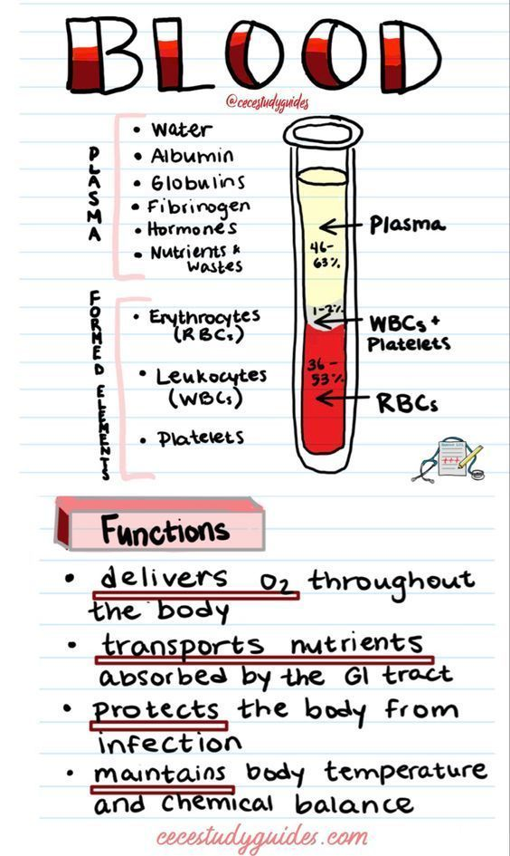
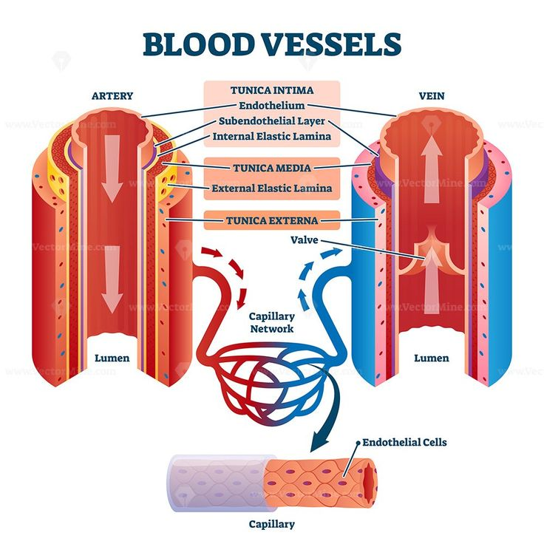
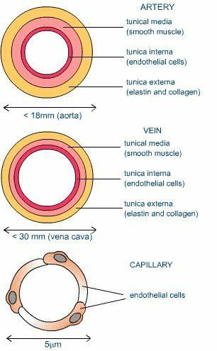
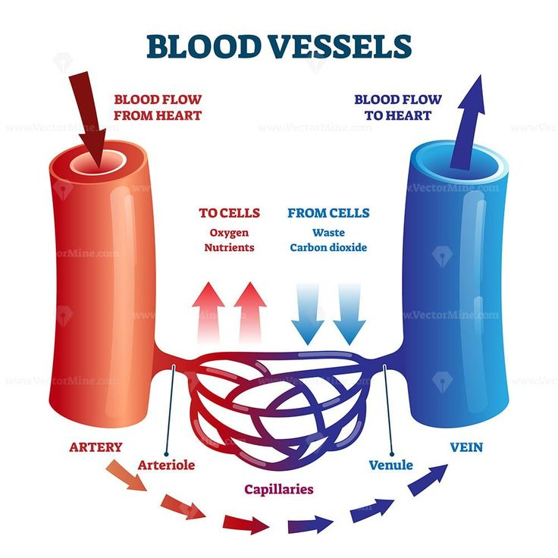

Slide 4
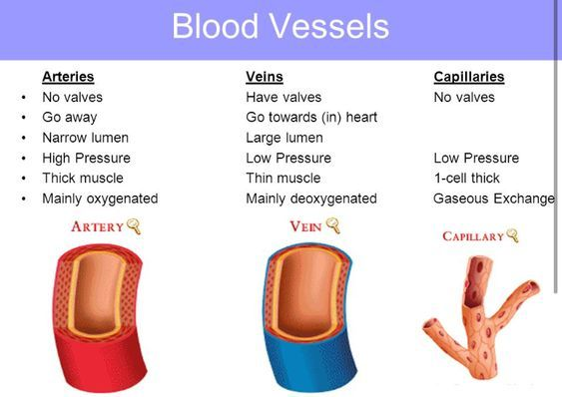
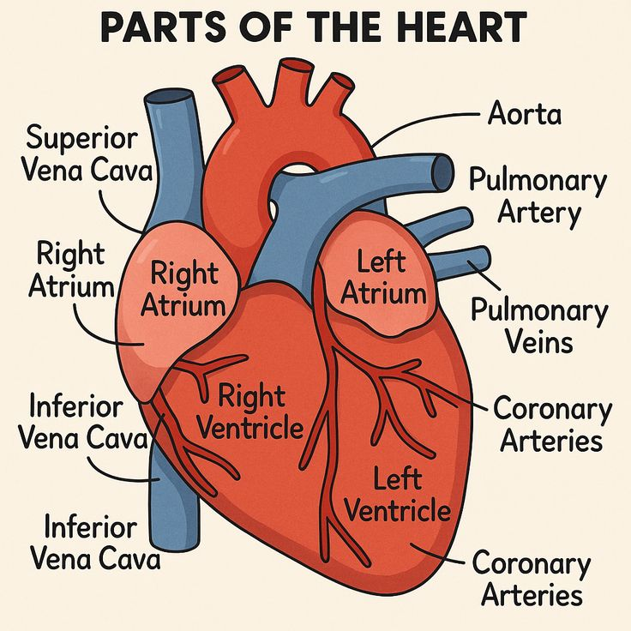
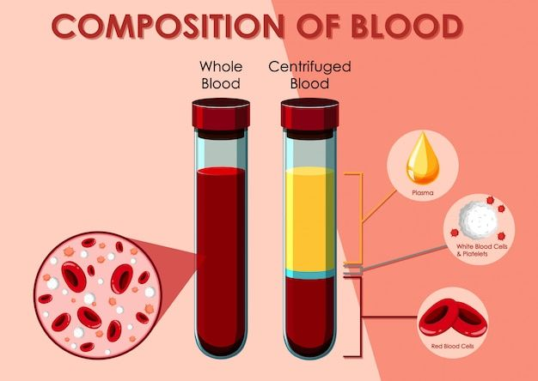

Slide 5
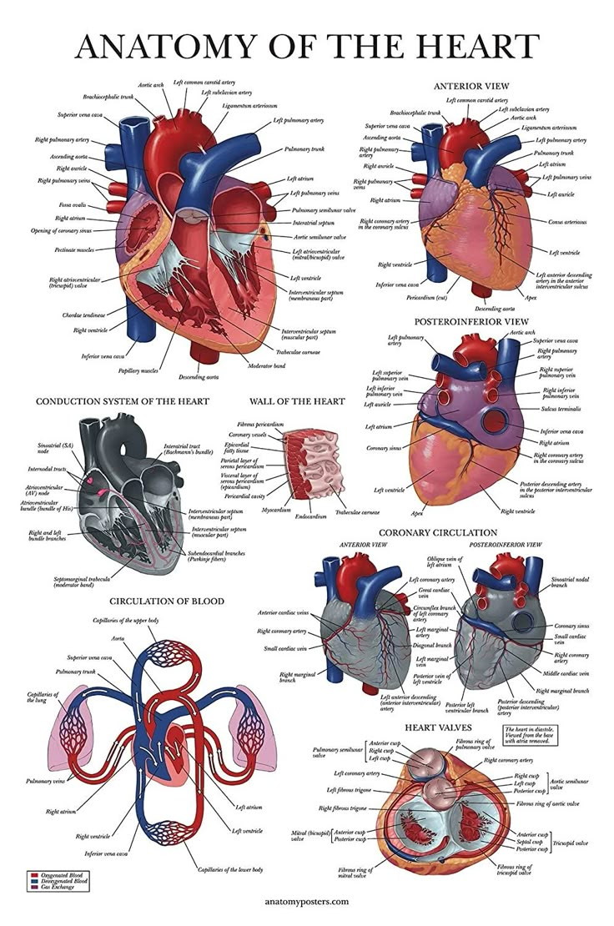
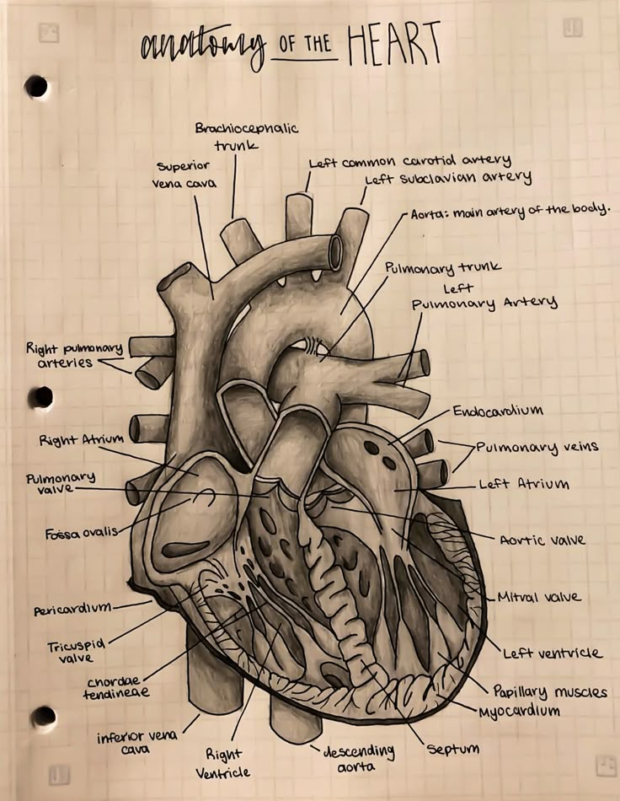

Slide 6
2. Definition
The cardiovascular system is the organ system responsible for the circulation of blood throughout the body, ensuring transport of oxygen, nutrients, hormones, and removal of carbon dioxide and metabolic wastes.

Slide 7
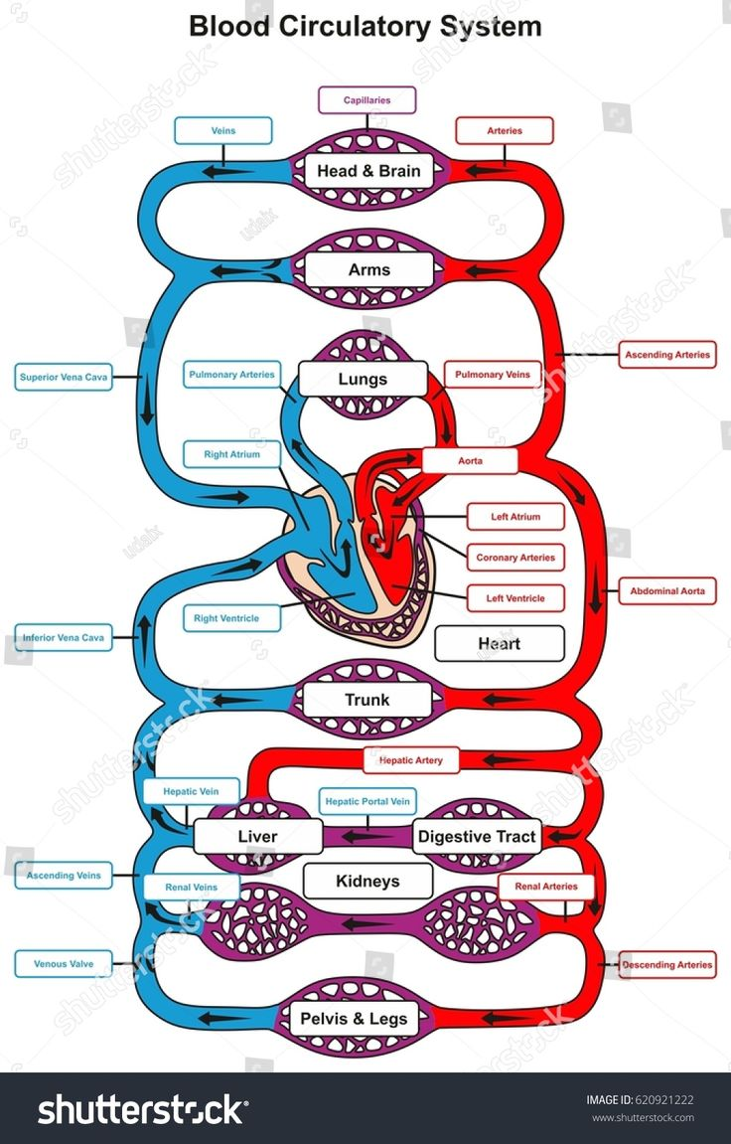
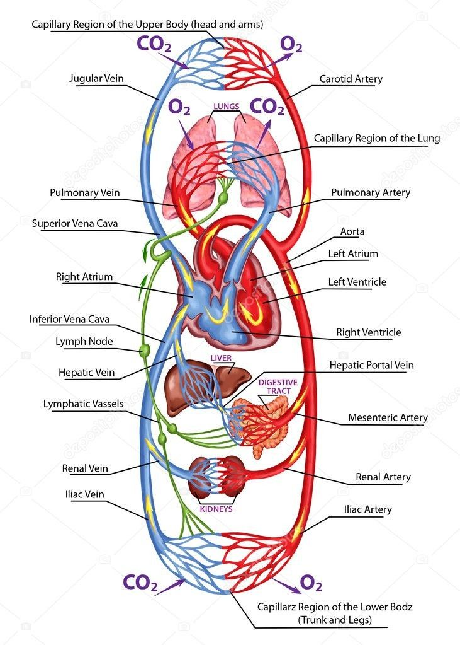

Slide 8
3. Functions of the Cardiovascular System
A. Transport
Oxygen → from lungs to tissues.
Carbon dioxide → from tissues to lungs.
Nutrients → from gastrointestinal tract to cells.
Hormones → from endocrine glands to target organs.
Waste products → to kidneys, liver, and lungs for excretion.
B. Regulation
Maintains body temperature (heat distribution).
Maintains pH balance and fluid–electrolyte balance.
Adjusts blood flow according to tissue needs (e.g., during exercise).
C. Protection
White blood cells & antibodies provide immunity.
Platelets & clotting factors prevent excessive blood loss.

Slide 9
Applied Anatomy (Clinical Importance): Pulse examination → radial, carotid, dorsalis pedis arteries. Blood pressure measurement → done on brachial artery using sphygmomanometer. Auscultation of heart sounds → diagnosis of murmurs, valve diseases. ECG (Electrocardiogram): records heart’s electrical activity. Coronary artery disease → narrowing/blockage of coronary arteries causes angina or myocardial infarction. Heart failure → inability of heart to pump blood effectively. Cardiopulmonary resuscitation (CPR): lifesaving procedure in cardiac arrest. Venipuncture & IV drug administration → knowledge of major veins required.

Slide 10
Auscultation is the medical process of listening to the internal sounds of the body with a stethoscope, typically to examine the heart, lungs, arteries, and abdomen

Slide 11
External Features of the Heart
1. General Appearance
Hollow, muscular, conical organ.
Size: ~12 × 9 × 6 cm (about clenched fist).
Weight: ~300 g (male), ~250 g (female).
Color: Reddish brown.
Location: Middle mediastinum of thoracic cavity, between lungs, above diaphragm.

Slide 12
2. Orientation Apex: Directed downwards, forwards, and to the left. Lies in 5th left intercostal space, ~9 cm from midline. Base: Broad upper end, directed backwards and to the right. Formed mainly by left atrium.

Slide 13
3. Borders of the Heart Right border → formed by right atrium. Left border → formed by left ventricle & part of left auricle. Inferior border → mainly right ventricle + part of left ventricle. Superior border → formed by atria and great vessels.

Slide 14
4. Surfaces of the Heart Anterior (Sternocostal surface): Faces sternum & ribs. Formed mainly by right ventricle, partly RA & LV. Inferior (Diaphragmatic surface): Rests on diaphragm. Formed mainly by left ventricle + part of RV. Left surface (Pulmonary surface): Faces left lung. Formed mainly by left ventricle. Right surface (Pulmonary surface): Faces right lung. Formed mainly by right atrium.

Slide 15
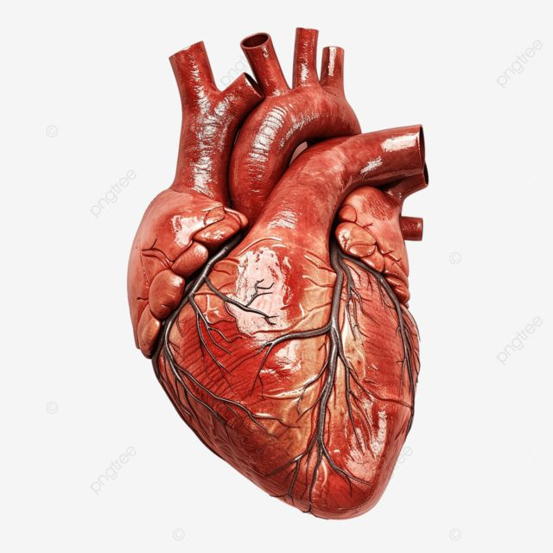
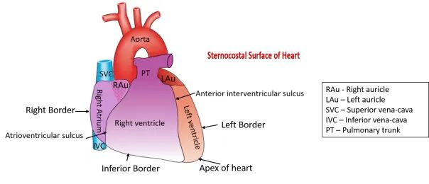
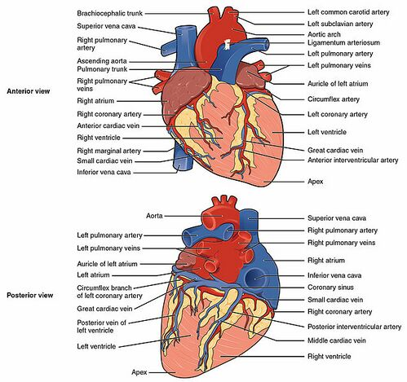

Slide 16
5. Grooves (Sulci) Grooves mark separation of chambers and carry coronary vessels. Coronary (Atrioventricular) sulcus → encircles heart; separates atria from ventricles. Anterior interventricular sulcus → between right & left ventricles (front). Posterior interventricular sulcus → between ventricles (back).

Slide 17
6. Major External Structures Auricles → small ear-like projections of atria (right & left auricle). Great vessels attached at base: Superior & Inferior vena cava (open into RA). Pulmonary trunk (arises from RV → lungs). 4 Pulmonary veins (open into LA). Aorta (arises from LV → systemic circulation).

Slide 18
7. Applied Anatomy Apex beat (apical impulse): felt in left 5th intercostal space, 9 cm from midline. Surface landmarks: important for auscultation of heart sounds & CPR. Grooves important surgically → contain coronary arteries & cardiac veins.

Slide 19
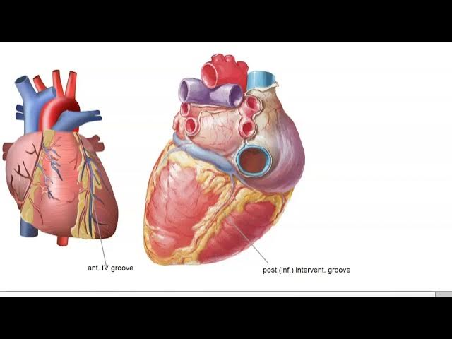
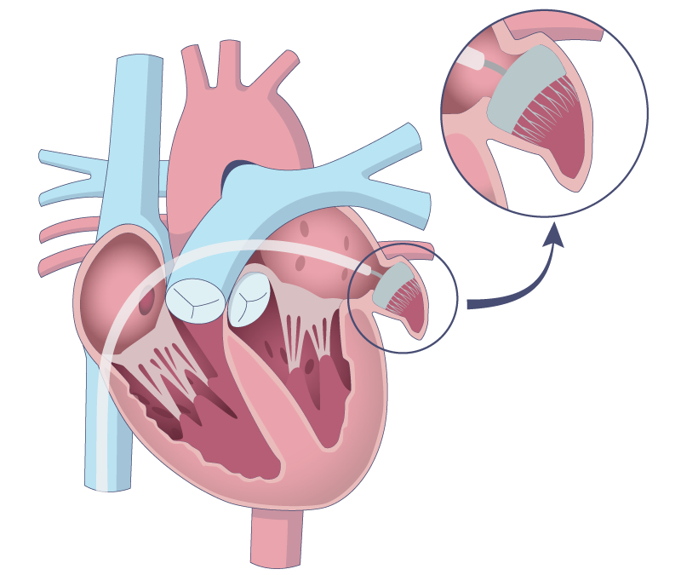
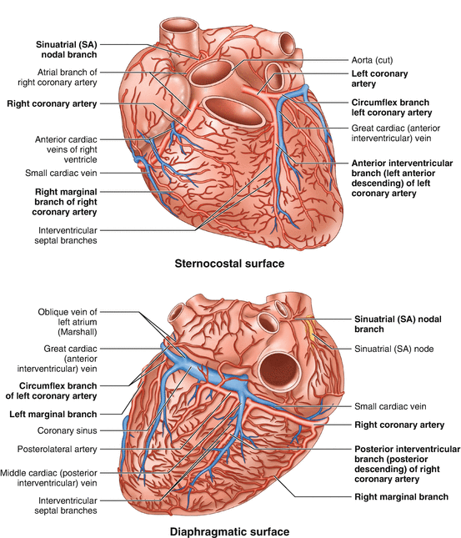
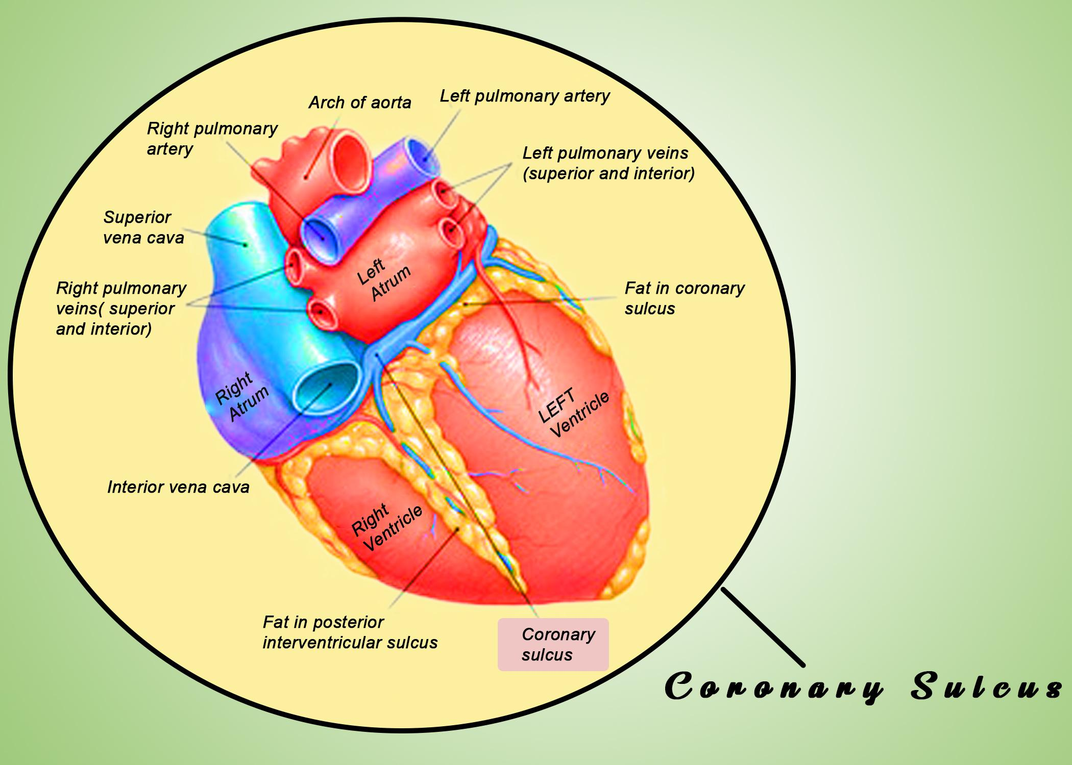
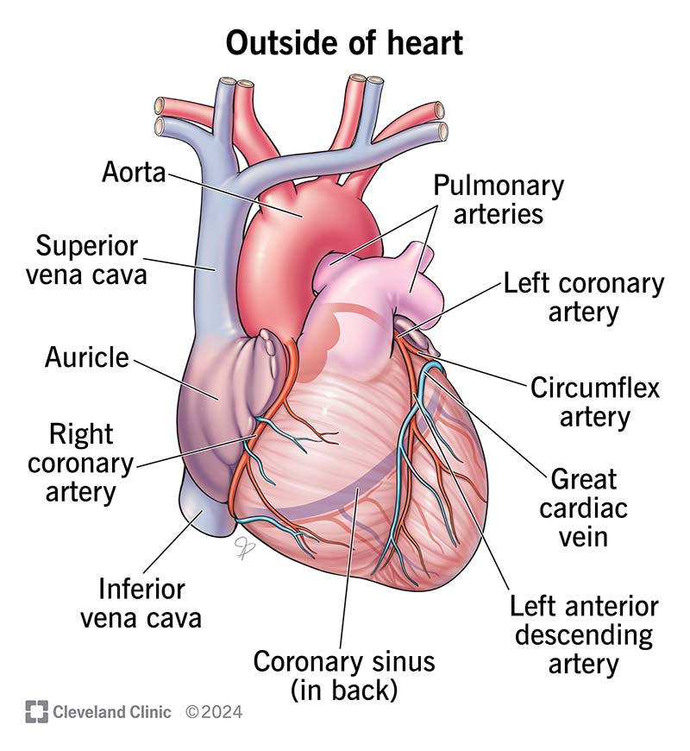

Slide 20
Chambers of heart > Right atrium {ra} > left atrium{la} > Right ventricle{rv} > left ventricle{lv}

Slide 21
Right Atrium 1. External Features Forms the right border of the heart. Has an ear-like projection → Right Auricle (increases atrial capacity). Receives: Superior vena cava (SVC) – opens at upper part of RA. Inferior vena cava (IVC) – opens at lower part. Coronary sinus – opens between IVC and tricuspid orifice. Small anterior cardiac veins.

Slide 22
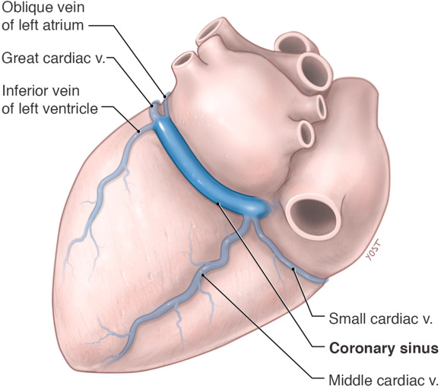

Slide 23
2. Internal Features The right atrium is divided internally into two parts by a vertical ridge called the Crista Terminalis:

Slide 24
A. Sinus Venarum (Posterior smooth part) Located posterior to crista terminalis. Smooth-walled region. Derived embryologically from sinus venosus. Openings present: SVC (upper part). IVC (lower part, guarded by Eustachian valve). Coronary sinus (guarded by Thebesian valve). Clinical: site where venous blood enters RA.

Slide 25
B. Atrium Proper (Anterior rough part) Located anterior to crista terminalis. Contains musculi pectinati (parallel muscular ridges). Extends into the auricle. Helps in contraction of atrium.

Slide 26
3. Interatrial Septum (Medial Wall of RA) Thin partition between RA and LA. Has an oval depression → Fossa Ovalis (remnant of foramen ovale of fetal life). Raised margin → Limbus fossa ovalis.

Slide 27
4. Tricuspid Opening Located in inferior part of RA, leading to right ventricle. Guarded by the Tricuspid Valve (3 cusps: anterior, posterior, septal). Allows blood flow RA → RV during atrial contraction.

Slide 28
Clinical importance: Atrial septal defect (ASD) occurs when foramen ovale fails to close. Thrombi may lodge in RA in cases of atrial fibrillation. IVC opening valve sometimes persists as Chiari network (abnormal).

Slide 29
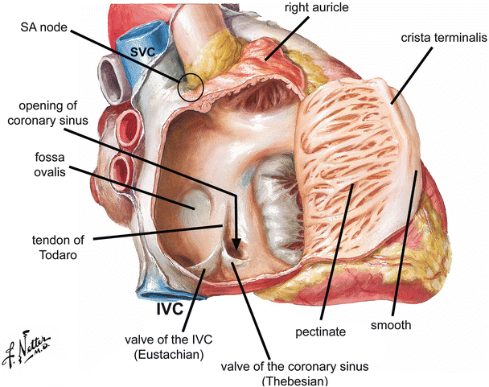
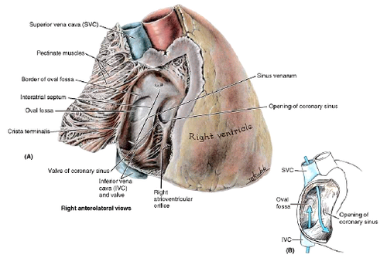
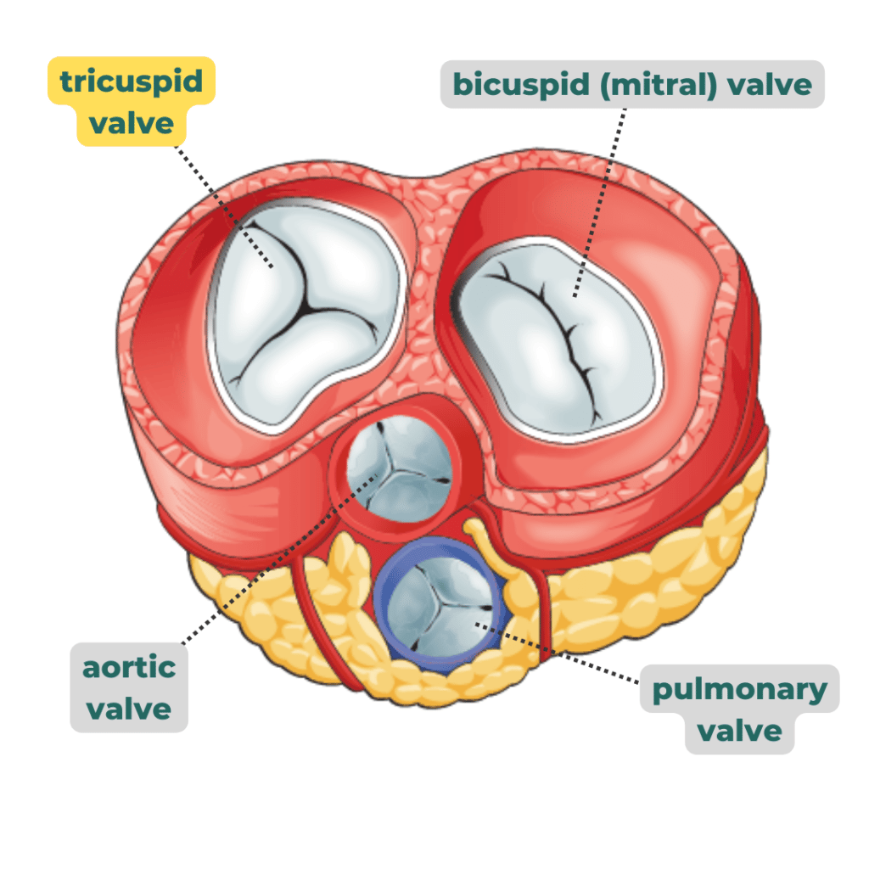
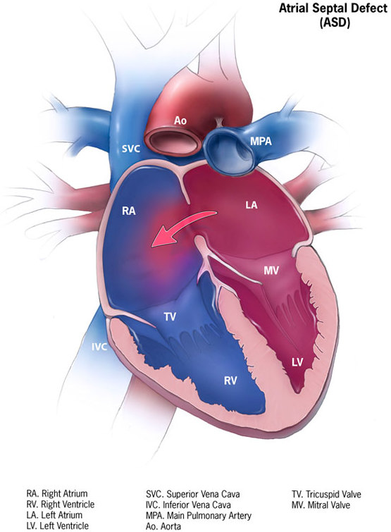
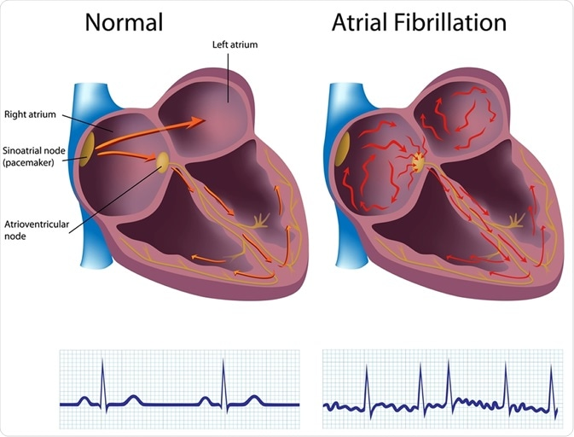
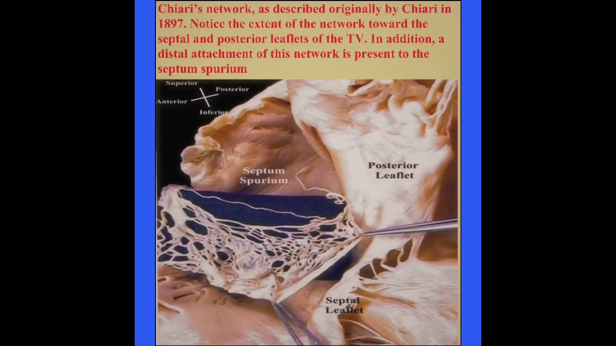

Slide 30
left Atrium One of the four chambers of the heart. Acts as a receiving chamber for oxygenated blood from the lungs via the pulmonary veins. Lies posterior to the right atrium, forming the base of the heart.

Slide 31
External Features Position: Forms most of the base (posterior surface) of the heart. Pulmonary veins: Four openings (two right, two left) drain into it. Left auricle: A small, ear-shaped muscular pouch projecting forward. Related posteriorly to: Esophagus (important in transesophageal echocardiography).

Slide 32
Internal Features Smooth posterior wall: Receives the 4 pulmonary veins. Auricle (anterior part): Contains pectinate muscles (comb-like ridges). Interatrial septum: Separates it from right atrium; may show impression of fossa ovalis (valve of foramen ovale from fetal life). Opening into left ventricle: The left atrioventricular orifice, guarded by the bicuspid/mitral valve.

Slide 33
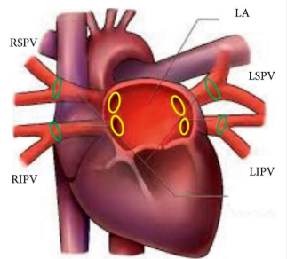
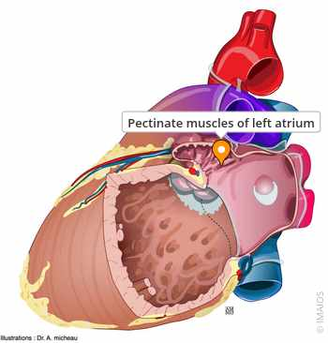
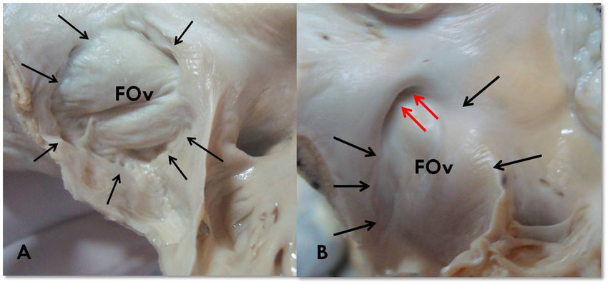

Slide 34
Bicuspid (Mitral) Valve Location: Between left atrium and left ventricle. Structure: Composed of two cusps: Anterior cusp (larger, semicircular). Posterior cusp (smaller, crescentic). Cusps are attached to the fibrous ring of the AV orifice. Chordae tendineae: Fibrous cords attaching cusps to papillary muscles of left ventricle. Function: Prevents backflow of blood from left ventricle into left atrium during systole.

Slide 35
Applied Anatomy Mitral valve stenosis: Narrowing due to rheumatic heart disease → left atrial enlargement, pulmonary congestion. Mitral regurgitation: Incompetence of valve → backflow into left atrium. Left atrial enlargement: Can compress esophagus → dysphagia. Clinical auscultation site: Apex beat (left 5th intercostal space, midclavicular line).

Slide 36
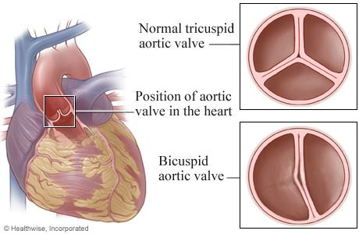
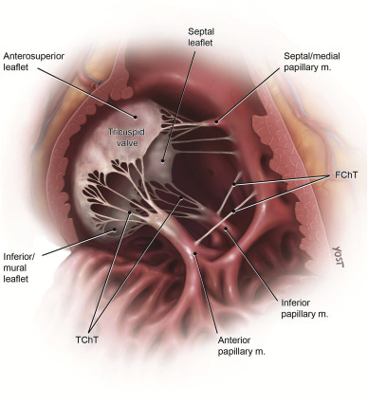
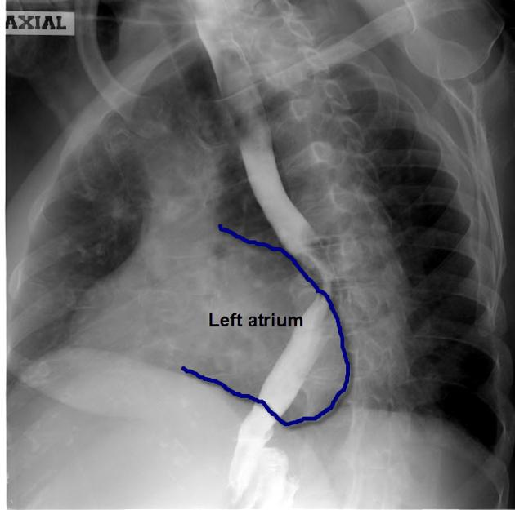
Dysphagia:
Difficulty in swallowing when the greatly enlarged heart chamber presses on the adjacent esophagus, a condition known as dysphagia megalatriensis or cardiovascular dysphagia

Slide 37
right ventricle The right ventricle is one of the two pumping chambers of the heart. Function: pumps deoxygenated blood into the pulmonary trunk → lungs for oxygenation. Lies anteriorly, forming most of the sternocostal (anterior) surface of the heart.

Slide 38
External Features Position: Forms most of the anterior (sternocostal) surface of the heart. Also contributes to inferior border. Shape: Crescent-shaped in cross-section (because left ventricle bulges into it). Apex contribution: Small part, but most of apex is by left ventricle. Grooves related: Anterior interventricular groove (with left anterior descending artery). Inferior border (sharp, rests on diaphragm). Great vessels: gives origin to pulmonary trunk at upper border.

Slide 39
Internal Features The right ventricle cavity is divided into 2 parts: (A) Inflow tract (venous part) Receives blood from right atrium via tricuspid valve. Features: Trabeculae carneae: irregular muscular ridges. Papillary muscles (3): Anterior, Posterior, Septal. Connected to tricuspid valve cusps by chordae tendineae. Moderator band (septomarginal trabecula): Muscular band from interventricular septum to anterior papillary muscle. Carries right branch of AV bundle (important for conduction). (B) Outflow tract (arterial part / Infundibulum / Conus arteriosus) Smooth-walled region leading to pulmonary trunk. Guarded by the pulmonary valve (with 3 semilunar cusps: anterior, right, left).

Slide 40
Applied Anatomy Ventricular septal defect (VSD): common congenital defect → blood shunts from LV → RV. Pulmonary valve stenosis: obstructs RV outflow → RV hypertrophy. Right heart failure: causes systemic venous congestion (edema, hepatomegaly). Moderator band: landmark in imaging; damage may affect conduction.

Slide 41
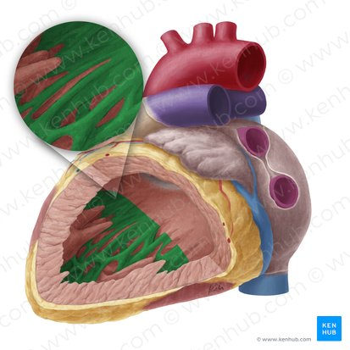
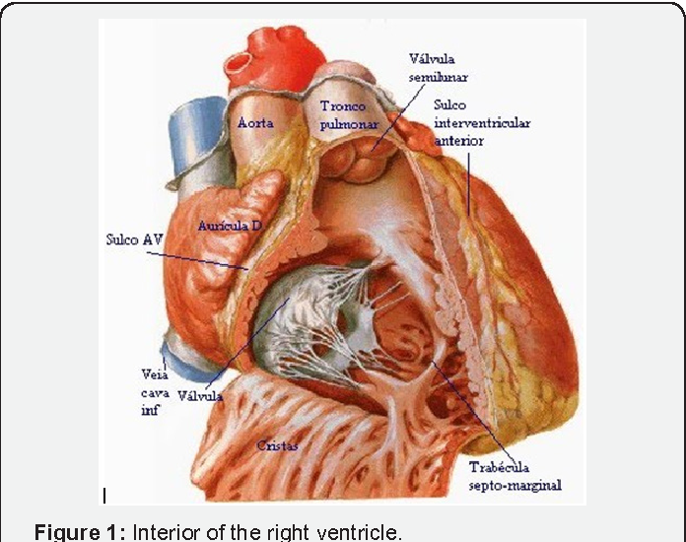
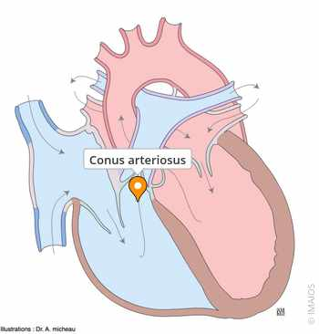
Trabeculae carneae

Slide 42
Left Ventricle The left ventricle (LV) is the main pumping chamber of the heart. Function: pumps oxygenated blood into the aorta for systemic circulation. Thicker wall (2–3 times thicker than RV) because it pumps against high systemic resistance.
.

Slide 43
External Features Position: Forms the apex of the heart. Contributes to the left border and diaphragmatic surface. Shape: Circular in cross-section (unlike crescentic RV). Grooves related: Anterior interventricular groove (with LAD artery). Posterior interventricular groove (with PDA). Great vessel: gives origin to the ascending aorta at its base.

Slide 44
Internal Features (A) Inflow tract (posterior part) Receives blood from the left atrium through the mitral (bicuspid) valve. Features: Trabeculae carneae: finer, more delicate than in RV. Papillary muscles: 2 large ones (anterior and posterior). Each connected to both cusps of the mitral valve via chordae tendineae, preventing prolapse during systole. (B) Outflow tract (Aortic Vestibule) Smooth-walled portion leading to the aortic orifice. Guarded by the aortic valve (3 semilunar cusps: right, left, posterior).

Slide 45
Applied Anatomy
Systemic hypertension: causes LV hypertrophy.
Aortic stenosis: obstruction at LV outflow → increased workload.
Mitral valve disease: stenosis or regurgitation → left atrial & LV dysfunction.
Myocardial infarction: commonly affects LV walls supplied by LAD artery.
LV failure: leads to pulmonary congestion and edema.

Slide 46
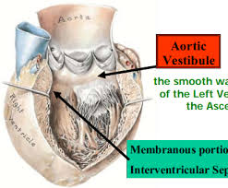
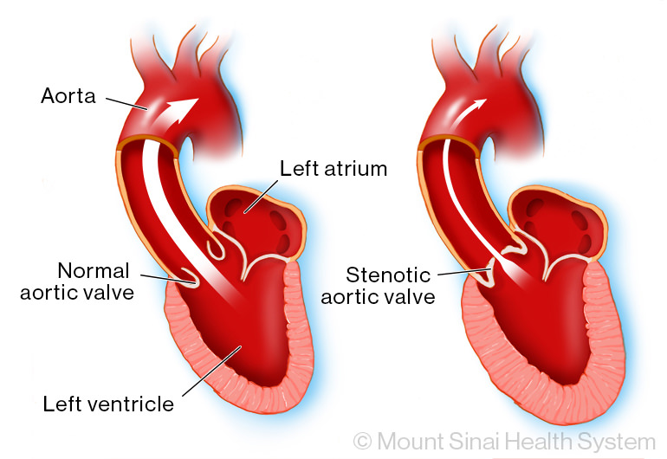
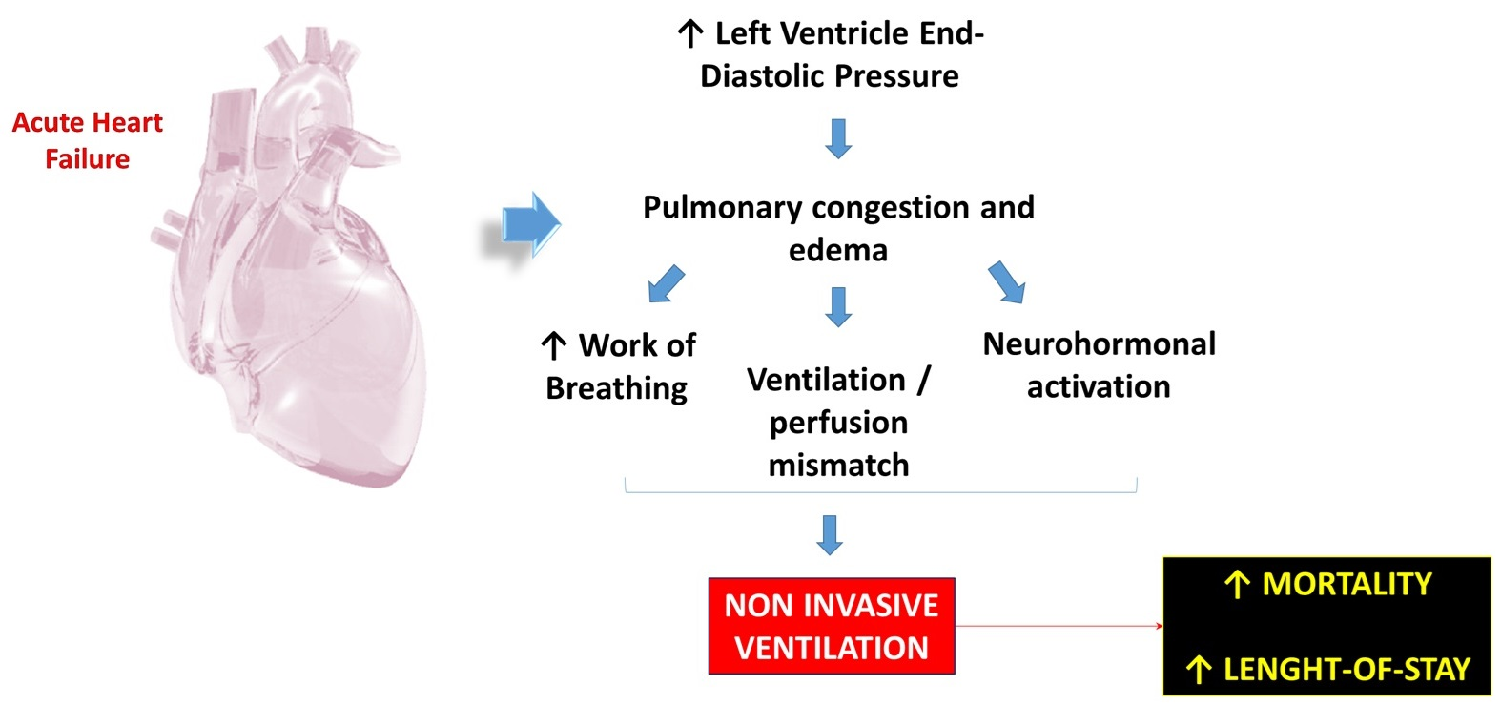

Slide 47
Nerve Supply of the Heart The heart is supplied by autonomic nervous system (ANS) through the cardiac plexus. Branches from superficial cardiac plexus and deep cardiac plexus

Slide 48
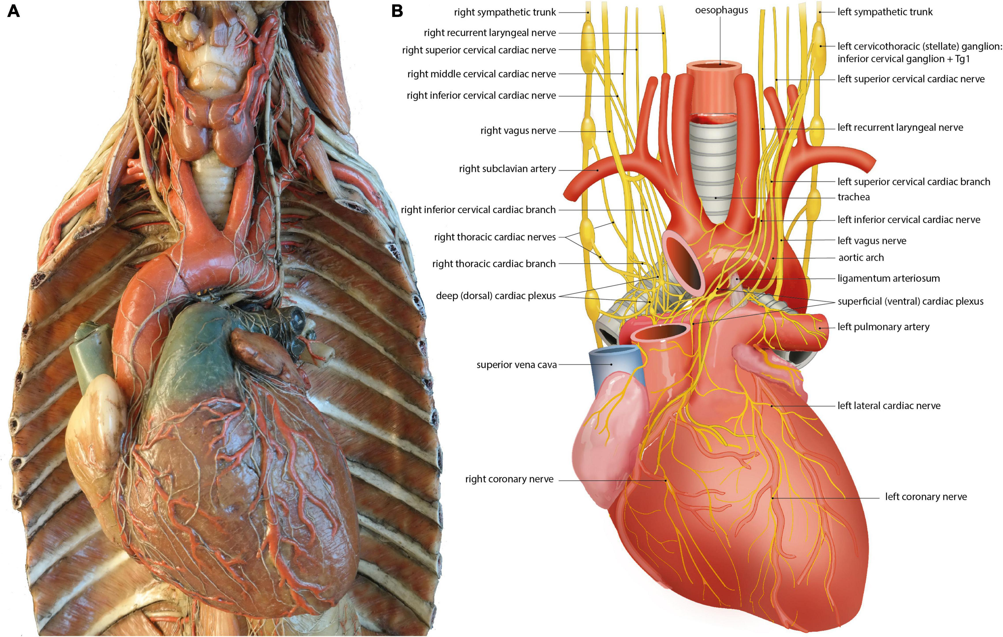

Slide 49
Blood supply arterial supply

Slide 50
Right Coronary Artery (RCA) One of the two main coronary arteries (other is Left Coronary Artery). Arises from the anterior aortic sinus of the ascending aorta. Runs in the right atrioventricular (coronary) sulcus. At the inferior border of the heart, curves posteriorly to reach the crux of the heart (where AV groove meets interventricular groove).

Slide 51
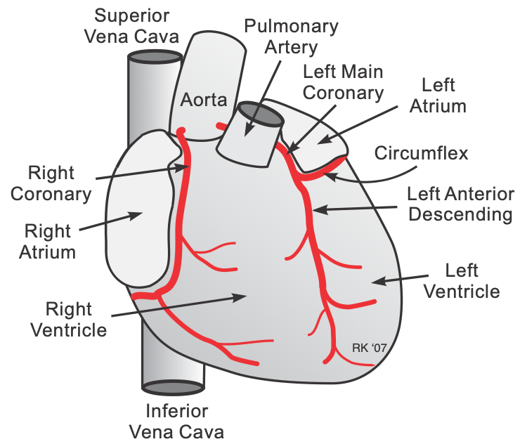
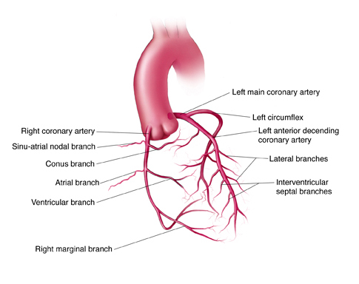

Slide 52
Branches of Right Coronary Artery Conus artery → supplies conus arteriosus of right ventricle. Right atrial branches → supply right atrium. Sinoatrial (SA) nodal branch (in 60% cases, RCA gives SA nodal artery; in 40%, from LCA). Right ventricular branches → supply right ventricle (including marginal artery). Right marginal artery → runs along inferior border of heart. Posterior interventricular branch (Posterior descending artery – PDA) → runs in posterior interventricular sulcus. Supplies posterior 1/3rd of interventricular septum. Atrioventricular (AV) nodal branch → arises near crux of heart; supplies AV node.

Slide 53
3. Areas Supplied by RCA Right atrium (except small part of interatrial septum). Most of right ventricle. Part of left ventricle (diaphragmatic surface). Posterior 1/3rd of interventricular septum. SA node (60% cases). AV node (90% cases).

Slide 54
4. Applied Anatomy RCA dominance: If RCA gives posterior interventricular artery → called right-dominant circulation (70% of people). LCA dominance: If LCA gives PDA → left-dominant circulation (10%). Balanced: If both contribute → balanced circulation (20%). Blockage of RCA → leads to myocardial infarction, especially involving right ventricle, inferior wall of LV, and conduction system (bradycardia, heart block). RCA commonly involved in inferior wall MI.

Slide 55
LEFT CORONARY ARTERY
One of the two coronary arteries supplying the heart (other is RCA).
Origin: arises from the left posterior aortic sinus of ascending aorta.
Course: passes between the left auricle and pulmonary trunk, then divides into its major branches.
Usually short (1–2 cm) before dividing

Slide 56
2. Branches of LCA Anterior Interventricular Branch (Left Anterior Descending – LAD): Runs in anterior interventricular groove to the apex. Gives: Diagonal branches → supply anterior LV wall. Septal branches → supply anterior 2/3 of interventricular septum. Circumflex Artery: Runs in left coronary (AV) sulcus to posterior surface of heart. Gives: Left marginal artery → supplies left ventricle. SA nodal branch (in 40% cases). Left Conus Artery (occasional small branch).

Slide 57
Areas Supplied by LCA Left atrium. Most of left ventricle (except part supplied by RCA). Part of right ventricle (anterior portion). Anterior 2/3rd of interventricular septum (via septal branches of LAD). SA node (40% of people, via circumflex branch). AV node (in ~10% cases, if circumflex gives AV nodal branch).

Slide 58
Applied Anatomy LCA is also called the “widow-maker” artery, because occlusion of proximal LAD is highly fatal. LAD occlusion → most common cause of anterior wall MI (affects LV and anterior septum). Circumflex occlusion → leads to lateral wall infarction of LV. Left dominance: If circumflex gives PDA → circulation is left-dominant (~10% cases). Coronary angiography is used to visualize RCA & LCA branches in suspected ischemic heart disease.

Slide 59
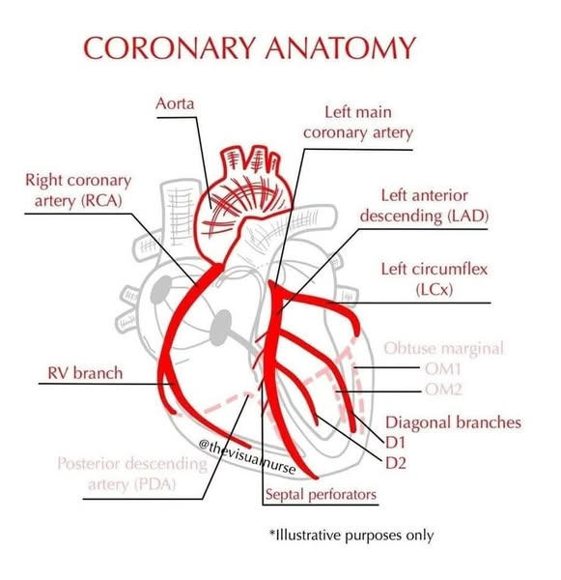
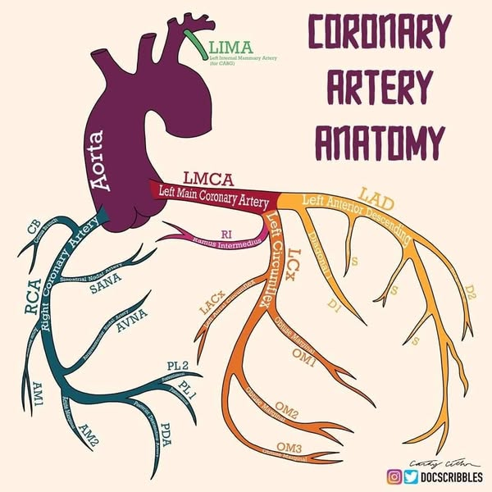

Slide 60
Coronary Sinus & Venous Drainage of the HeART The main venous channel of the heart. A wide, short venous sac (~2–3 cm long). Location: Posterior part of coronary sulcus, between left atrium and left ventricle. Opening: Opens into right atrium between the opening of the inferior vena cava (IVC) and tricuspid orifice. Guarded by a semicircular fold → Thebesian valve.

Slide 61
. Tributaries of Coronary Sinus The coronary sinus receives most of the venous blood of the heart (~85%). Its tributaries are: Great Cardiac Vein → accompanies LAD, drains anterior LV and septum. Middle Cardiac Vein → accompanies PDA, drains posterior LV and septum. Small Cardiac Vein → runs with RCA in coronary sulcus, drains RA and RV. Posterior Vein of LV → drains diaphragmatic surface of LV. Oblique Vein of LA (Marshall’s vein) → small vein on posterior LA, embryological remnant of left SVC.

Slide 62
Anterior Cardiac Veins Several small veins from the anterior surface of RV. Drain directly into the right atrium, not into coronary sinus. Important exception to usual venous drainage pattern. Venae Cordis Minimae (Thebesian Veins) Numerous tiny veins within the walls of all chambers of the heart. Open directly into corresponding chambers: More numerous in right atrium & right ventricle. Fewer n left atrium & left ventricle. Function: provide direct venous drainage into chambers

Slide 63
LYMPHATIC DRAINAGE: The heart has a rich lymphatic network in the subendocardial, myocardial, and subepicardial layers. Lymph vessels begin as fine capillaries → form larger channels → drain into regional lymph nodes of thorax. Two major lymphatic trunks arise from the heart: A. Right cardiac lymph trunk B. Left cardiac lymph trunk

Slide 64
Applied Anatomy Spread of infections & tumors Infections (pericarditis, myocarditis, endocarditis) may spread via cardiac lymphatics to mediastinal nodes. Cardiac tumors (rare) and lung carcinomas may metastasize through shared lymphatic pathways. Coronary artery disease Impaired lymph drainage contributes to myocardial edema and worsens ischemic injury. Heart transplant surgery Cardiac lymphatics are severed during transplant; impaired lymph drainage may cause edema of the graft. Pericardial effusion Normally, lymphatics help clear small amounts of pericardial fluid. In blockage, fluid may accumulate → tamponade

Slide 65
Fetal Circulation & Birth Changes Introduction Fetal circulation is adapted to: Receive oxygen & nutrients from placenta (not lungs & GIT). Bypass non-functional fetal lungs. Special shunts and vessels exist to ensure this.

Slide 66
Main Features of Fetal Circulation Umbilical vein Brings oxygenated blood from placenta → fetus. Blood passes through ductus venosus (bypasses liver) → IVC. Right atrium Oxygen-rich blood from IVC directed through foramen ovale → left atrium. Less oxygenated blood from SVC goes → right ventricle → pulmonary trunk. Right ventricle & pulmonary trunk Most blood bypasses lungs via ductus arteriosus → descending aorta. Descending aorta Supplies lower body & returns blood via umbilical arteries → placenta for oxygenation.

Slide 67
Changes at Birth At birth, when the umbilical cord is clamped and baby takes first breath, major circulatory changes occur: Closure of umbilical vessels Umbilical arteries → medial umbilical ligaments. Umbilical vein → ligamentum teres of liver. Ductus venosus → ligamentum venosum. Closure of foramen ovale Increased LA pressure (due to pulmonary venous return) forces septum primum against septum secundum. Forms fossa ovalis in adult. Closure of ductus arteriosus Functional closure by smooth muscle contraction (within hours). Anatomical closure in weeks → ligamentum arteriosum. Increased pulmonary circulation Lungs expand → pulmonary resistance drops → more blood flows through pulmonary arteries → left atrium. Ductus venosus closure Stops direct shunt from umbilical vein → IVC.

Slide 68
ARTERIES OF THE BODY

Slide 69
Arteries of thorax and abdomen aorta Definition & Importance The largest artery in the human body. Origin: from the left ventricle of the heart. Function: supplies oxygenated blood to all tissues of the body except the lungs.

Slide 70
Parts of the Aorta A. Ascending Aorta Origin: left ventricle, at the aortic orifice. Lies within the pericardium. Branches: Right coronary artery. Left coronary artery.

Slide 71
B. Arch of Aorta Curves upward, backward, and to the left in the superior mediastinum. Branches (classic 3): Brahiocephalic trunk → right common carotid & right subclavian arteries. Left common carotid artery. Left subclavian artery.

Slide 72
C. Descending Thoracic Aorta Extends from T4 → T12 (through posterior mediastinum). Branches: Bronchial arteries (to lungs). Esophageal arteries (to esophagus). Pericardial branches. Posterior intercostal arteries. Superior phrenic arteries (to diaphragm).

Slide 73
D. Abdominal Aorta Begins at T12, ends at L4, dividing into right and left common iliac arteries. Branches: Visceral branches: Celiac trunk. Superior mesenteric artery (SMA). Inferior mesenteric artery (IMA). Renal arteries. Suprarenal arteries. Gonadal arteries. Parietal branches: Inferior phrenic arteries. Lumbar arteries. Median sacral artery.

Slide 74
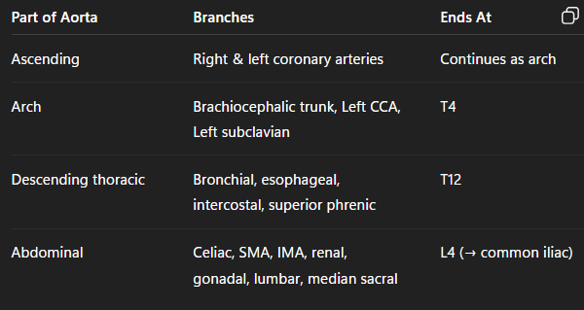

Slide 75
Celiac Trunk (Celiac Artery) extent and definition: A short, wide arterial trunk arising from the abdominal aorta. Origin: From the front of abdominal aorta at the level of T12 vertebra (just below aortic hiatus of diaphragm). Length: ~1.5–2 cm long. Course: Almost horizontal, runs forward and divides into 3 main branches

Slide 76
Branches of Celiac Trunk Left Gastric Artery Smallest branch. Runs upward & left, then along lesser curvature of stomach. Gives: esophageal branches, gastric branches. Splenic Artery Largest branch. Tortuous course along upper border of pancreas → hilum of spleen. Gives: Pancreatic branches. Short gastric arteries. Left gastroepiploic artery. Common Hepatic Artery Runs to the right, divides into: Proper hepatic artery → right & left hepatic arteries (to liver). Right gastric artery. Gastroduodenal artery (→ right gastroepiploic & superior pancreaticoduodenal).

Slide 77
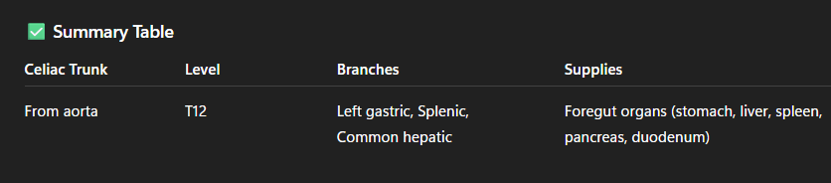

Slide 78
Superior Mesenteric Artery (SMA) Definition & Extent The second unpaired ventral branch of the abdominal aorta (after the celiac trunk). Origin: Arises from the anterior surface of the abdominal aorta at te level of L1 vertebra, just below the celiac trunk. Course: Passes behind the body of the pancreas, then emerges between the pancreas and the lower part of the duodenum. Runs downward and forward within the mesentery toward the right iliac fossa. Length: Around 20–25 cm. Think of it as a “big supply line” running like a river in the mesentery, giving off tributaries (branches) to irrigate the midgut organs.

Slide 79
Branches of SMA (A) Left-Sided Branches Inferior Pancreaticoduodenal Artery Divides into anterior & posterior branches. Anastomoses with superior pancreaticoduodenal artery (from celiac trunk). Supplies: head of pancreas + duodenum. Jejunal Arteries 12–15 branches. Form arterial arcades in mesentery → supply jejunum. Ileal Arteries More numerous, with more complex arcades. Supply ileum.

Slide 80
(B) Right-Sided Branches Middle Colic Artery Runs in transverse mesocolon. Supplies transverse colon. Right Colic Artery Supplies ascending colon. Ileocolic Artery Lowest branch, runs toward ileocecal junction. Supplies terminal ileum, cecum, appendix, and lower ascending colon.

Slide 81
(C) Terminal Branch Ileocolic artery is often considered the terminal branch, but overall SMA continues into the mesentery distributing jejunal/ileal branches.

Slide 82
Arteries of head and neck common carotid artery The main artery of the head and neck, supplying blood to the brain, face, and neck. Two in number: Right and Left.

Slide 83
Extent & Course Ascends vertically in the neck within the carotid sheath, lateral to trachea and esophagus. Extent: From origin → upper border of thyroid cartilage (C3–C4 level). At this point, it bifurcates into: Internal carotid artery (to brain, eye). External carotid artery (to face, neck, scalp).

Slide 84
Branches In the neck: The common carotid artery gives no branches. At its termination → divides into: Internal carotid artery (no branches in neck, enters skull). External carotid artery (gives 8 branches: 6 in neck + 2 terminal).

Slide 85
External Carotid Artery (ECA) One of the two terminal branches of the common carotid artery (the other being the internal carotid artery). Supplies the face, scalp, neck, jaws, tongue, pharynx, thyroid, and part of dura mater.

Slide 86
Extent Origin: At the level of upper border of thyroid cartilage (C3–C4 vertebra), from the bifurcation of common carotid artery. Course: Ascends in the neck anteromedial to internal carotid artery initially, then becomes anterolateral. Passes deep to posterior belly of digastric and stylohyoid. Enters the parotid gland, where it terminates. Termination: Within the parotid gland → divides into its 2 terminal branches: Superficial temporal artery. Maxillary artery.

Slide 87
Branches of External Carotid Artery Mnemonic (for 8 branches): “Some Angry Lady Figured Out PMS” (S = Superior thyroid, A = Ascending pharyngeal, L = Lingual, F = Facial, O = Occipital, P = Posterior auricular, M = Maxillary, S = Superficial temporal) (A) Anterior branches Superior thyroid artery → thyroid gland, larynx. Lingual artery → tongue. Facial artery → face, lips, tonsils, submandibular gland. (B) Posterior branches Occipital artery → scalp at back of head. Posterior auricular artery → auricle, scalp behind ear. (C) Medial branch Ascending pharyngeal artery → pharynx, prevertebral muscles, middle ear, meninges. (D) Terminal branches Maxillary artery → jaws, teeth, muscles of mastication, nasal cavity. Superficial temporal artery → scalp, parotid gland, temporalis muscle.

Slide 88
Internal Carotid Artery (ICA) One of the two terminal branches of the common carotid artery (the other is external carotid artery). Major artery supplying the brain, eyes, forehead, and part of nose. No branches in the neck.

Slide 89
Extent Origin: From the common carotid artery bifurcation at the upper border of thyroid cartilage (C3–C4 level). Termination: At the base of the brain, by dividing into: Anterior cerebral artery (ACA). Middle cerebral artery (MCA).

Slide 90
Branches of Internal Carotid Artery (A) In Petrous Part Caroticotympanic arteries. Artery of pterygoid canal. (B) In Cavernous Part Cavernous branches to dura and pituitary. (C) In Cerebral Part Ophthalmic artery → eye, orbit, face. Posterior communicating artery → joins posterior cerebral artery (part of Circle of Willis). Anterior choroidal artery → choroid plexus, optic tract, hippocampus, internal capsule. Terminal branches: Anterior cerebral artery (ACA) → medial surface of cerebral hemisphere. Middle cerebral artery (MCA) → lateral surface of cerebral hemisphere

